Slide 1
Social Media
Seethamraju Rekha
Pimpalgaonkar Abhinav
Lafon Benoit
Based on Instagram
CS 521 - OBJECT-ORIENTED DESIGN AND ANALYSIS

Slide 2
Analysis Class Diagram
Represents the meaningful concepts in a problem domain
Requires existing use cases and actors
They illustrate ideas,thing or objects and association between them
Attributes need not be primitive datatypes.
Decomposes the problem domain into comprehensible units

Slide 3
Design Class Diagram
Design mainly represents a transition of ‘what’ a system can do and ‘how’ a system do it.
Classes needed to implement a system that meets the requirements
Based on Analysis/Domain Model
Attributes and methods needed in each class
The interaction between various classes in the design

Slide 4
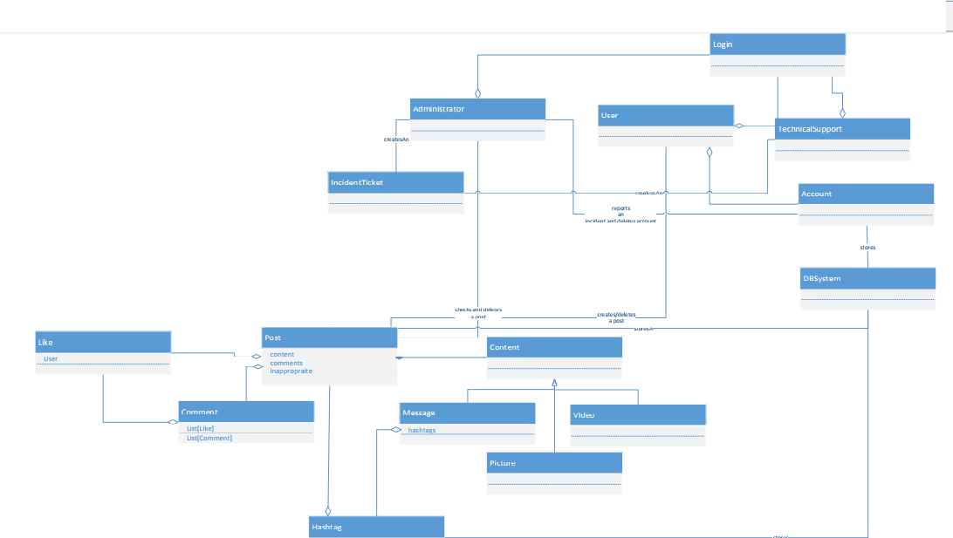
Class Diagram

Slide 5
Design Pattern
Design Pattern is a general repeatable solution to a commonly occurring problems in software design.
It is description or a template for how to solve a problem that can be used in many different situations.
Reusing design patterns helps to prevent subtle issues that can cause major problems and improves code readability for coders and architects familiar with the patterns.
The idea of a design pattern is an attempt to standardize what are already accepted best practices.

Slide 6
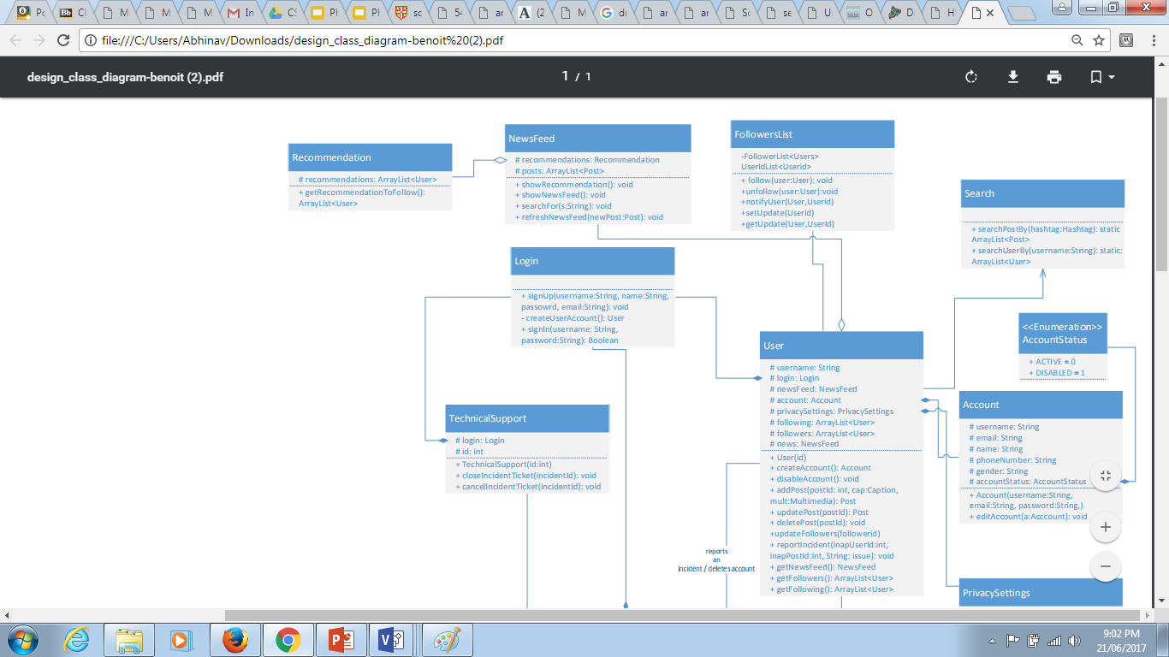
Design Pattern-ObserverPattern

Slide 7
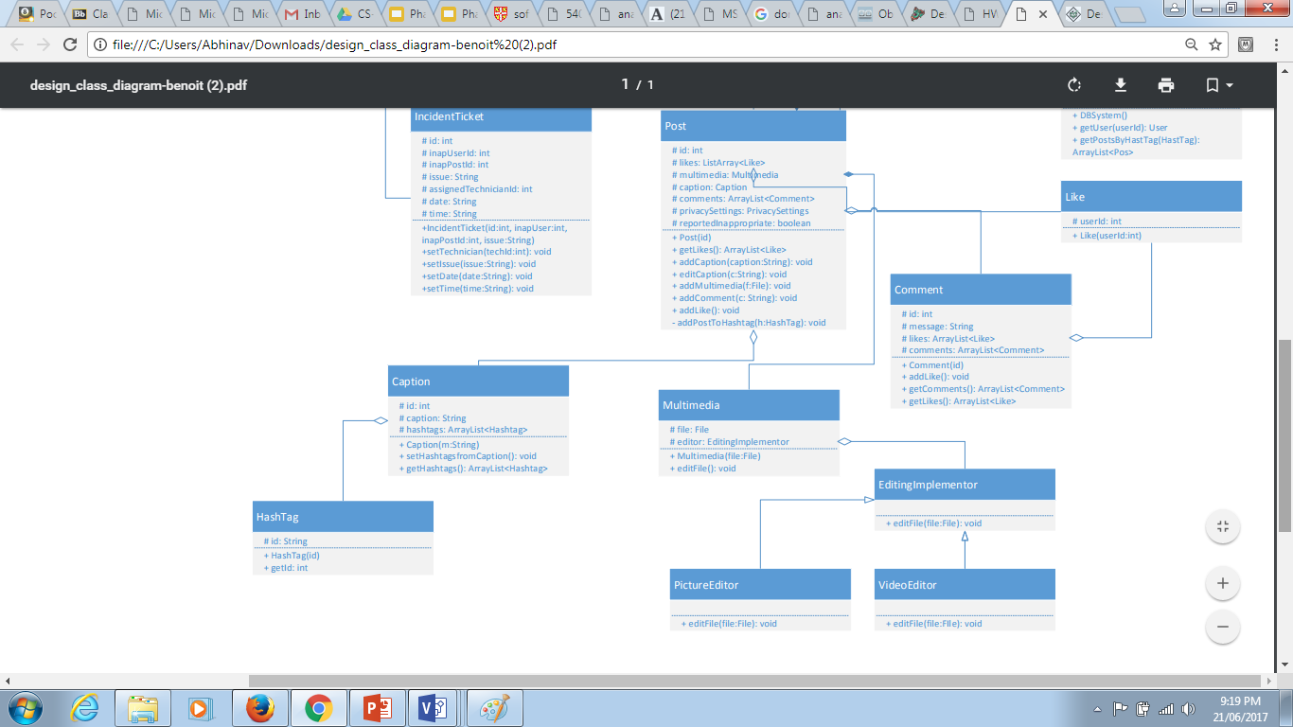
Design Pattern-Bridge Pattern

Slide 8
Sequence Diagram
Captures the interaction between objects in a time sequence
Represents the flow of message, events and actions between objects of the system
They describes the logical flow of the system
Represents the actual working of the system for a particular scenario.

Slide 9
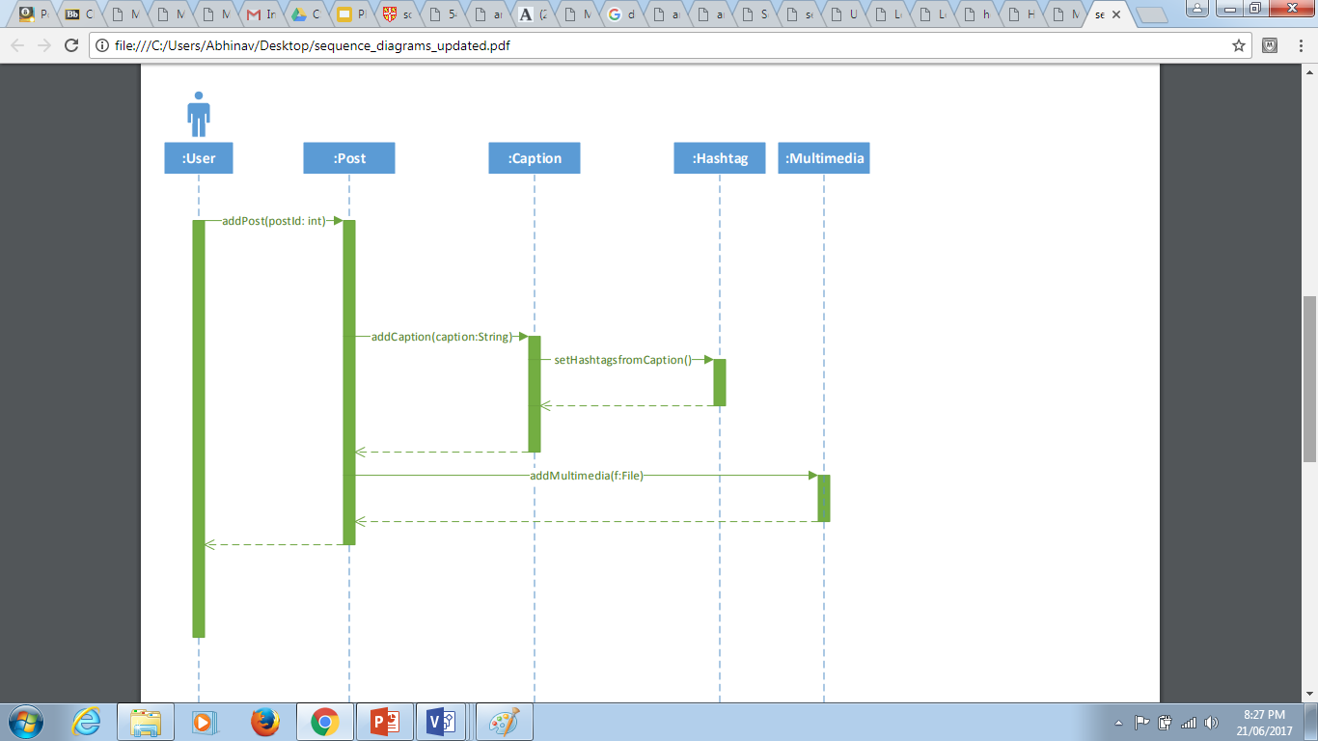
Sequence Diagram
User Adds a post

Slide 10
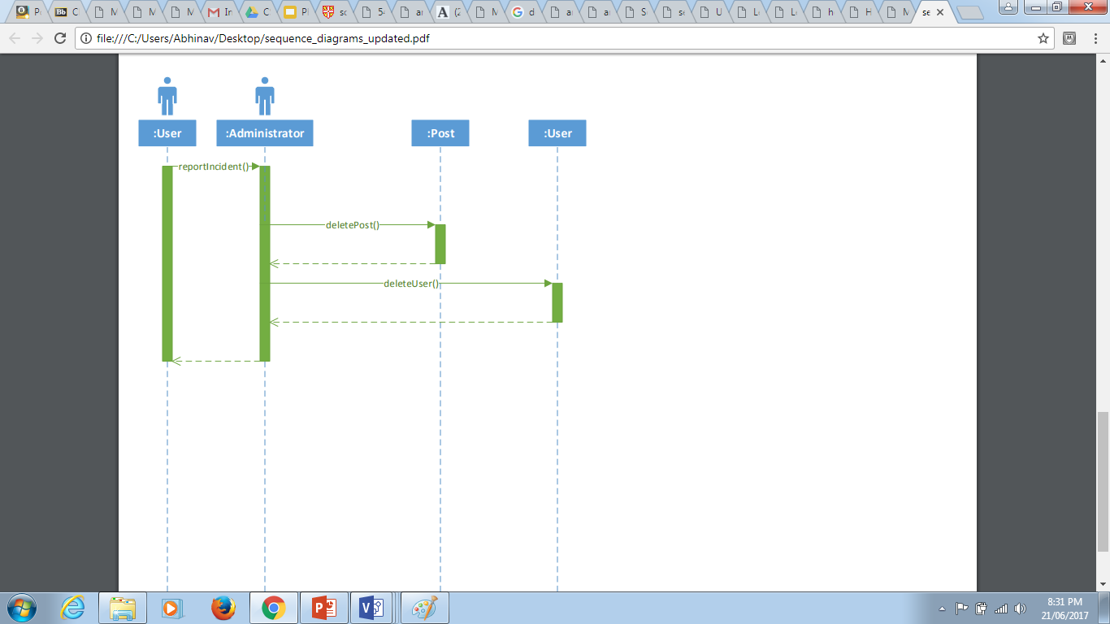
Sequence Diagram
User Reports an Incident and Admin deletes the post and the user

Slide 11
Thank You

